Slide 1
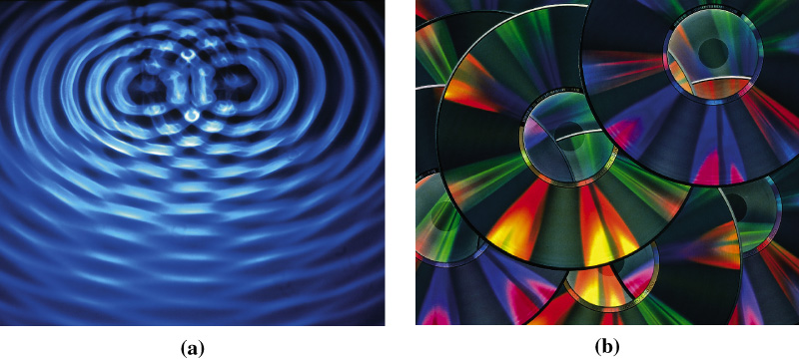
Chapter 9: Electrons in Atoms
General Chemistry
Principles and Modern Applications
Petrucci • Harwood • Herring
8th Edition
Philip Dutton
University of Windsor, Canada
Prentice-Hall © 2002
Notes:
Thermochemistry branch of chemistry concerned with heat effects accompanying chemical reactions.
Direct and indirect measurement of heat.
Answer practical questions: why is natural gas a better fuel than coal, and why do fats have higher energy value than carbohydrates and protiens.

Slide 2
Contents
9-1 Electromagnetic Radiation
9-2 Atomic Spectra
9-3 Quantum Theory
9-4 The Bohr Atom
9-5 Two Ideas Leading to a New Quantum Mechanics
9-6 Wave Mechanics
9-7 Quantum Numbers and Electron Orbitals

Slide 3
Contents
9-8 Quantum Numbers
9-9 Interpreting and Representing Orbitals of the Hydrogen Atom
9-9 Electron Spin
9-10 Multi-electron Atoms
9-11 Electron Configurations
9-12 Electron Configurations and the Periodic Table
Focus on Helium-Neon Lasers

Slide 4
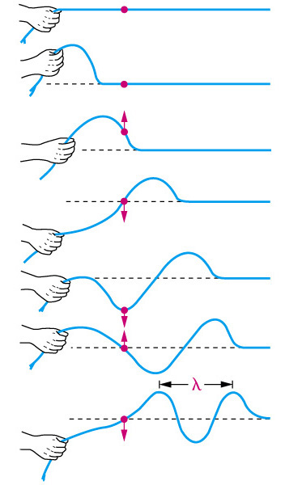
9-1 Electromagnetic Radiation
Electric and magnetic fields propagate as waves through empty space or through a medium.
A wave transmits energy.

Slide 5
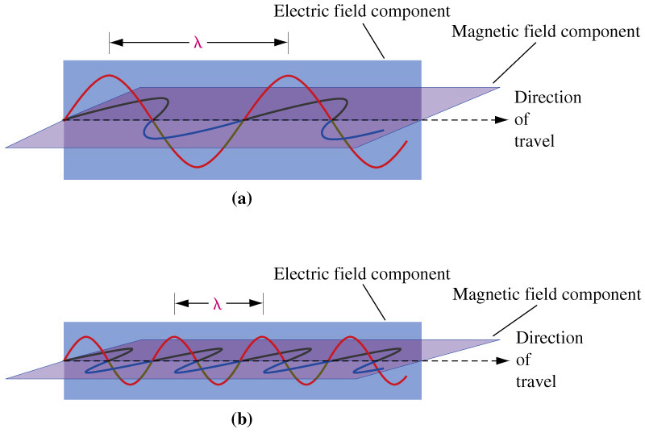
EM Radiation
Low ν
High ν

Slide 6
Frequency, Wavelength and Velocity
Frequency (ν) in Hertz—Hz or s⁻¹.
Wavelength (λ) in meters—m.
    cm μm nm  pm
    (10⁻² m) (10⁻⁶ m) (10⁻⁹ m) (10⁻¹⁰ m) (10⁻¹² m)
Velocity (c)—2.997925  10⁸ m s⁻¹.
    c = λν λ = c/ν ν= c/λ

Slide 7
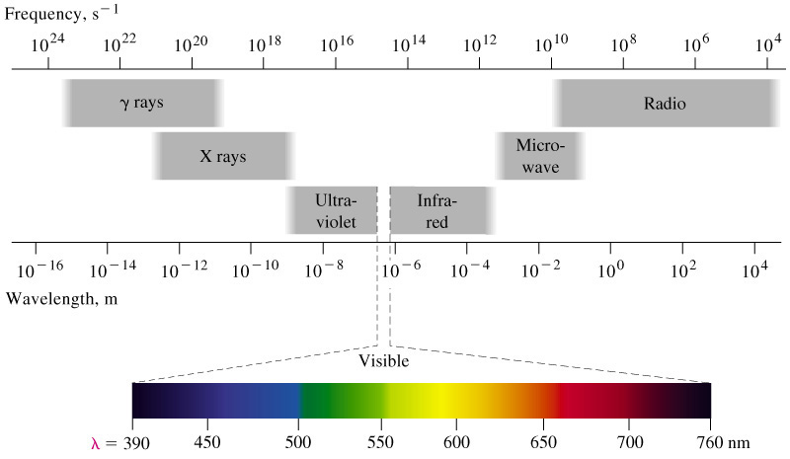
Electromagnetic Spectrum

Slide 8
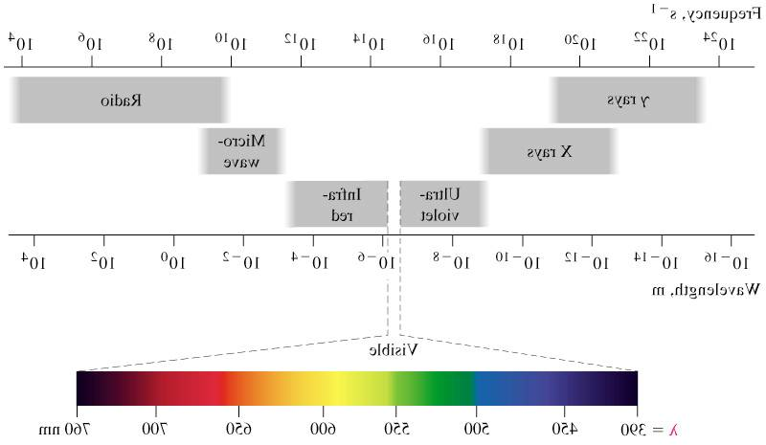
ROYGBIV
Red
Orange
Yellow
700 nm
Green
450 nm
Blue
Indigo
Violet
Prentice-Hall ©2002 General Chemistry: Chapter 9 Slide 8

Slide 9
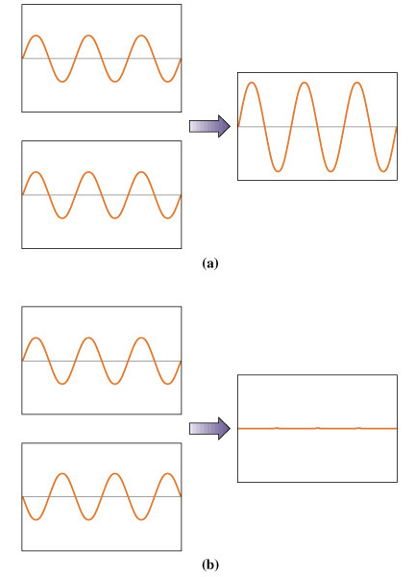
Constructive and Destructive Interference

Slide 11
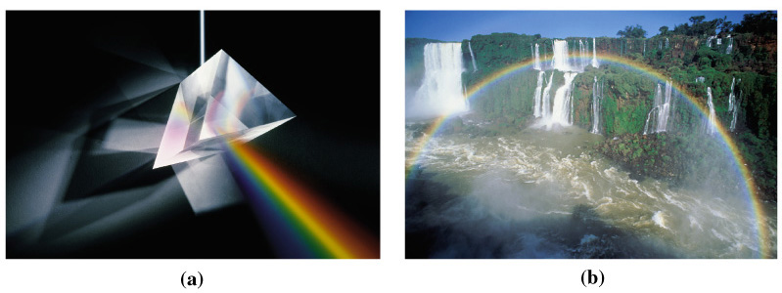
Refraction of Light

Slide 12
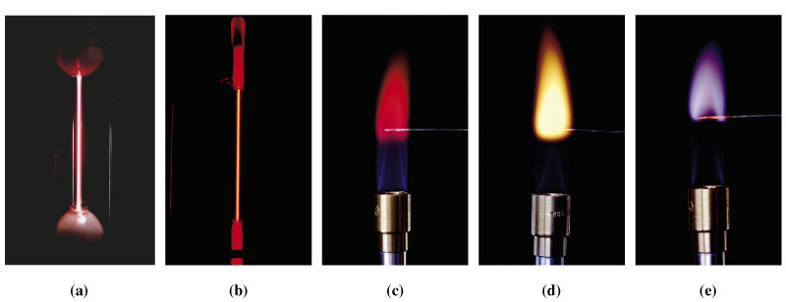
9-2 Atomic Spectra
Notes:
Hydrogen
Helium
Lithium
Sodium
Potassium

Slide 13
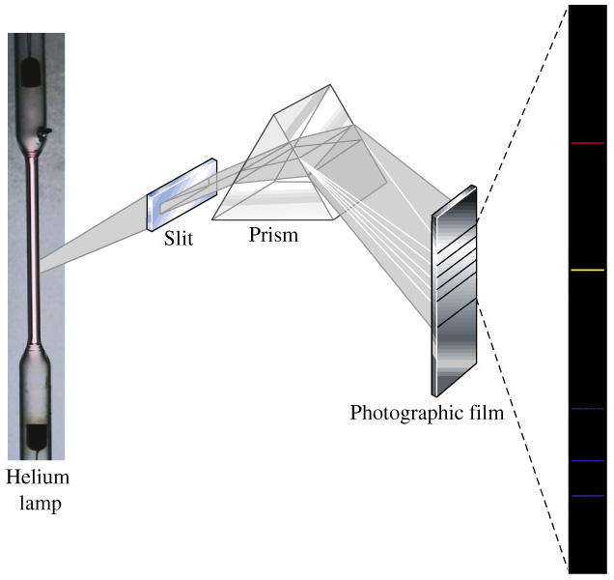
Atomic Spectra

Slide 14
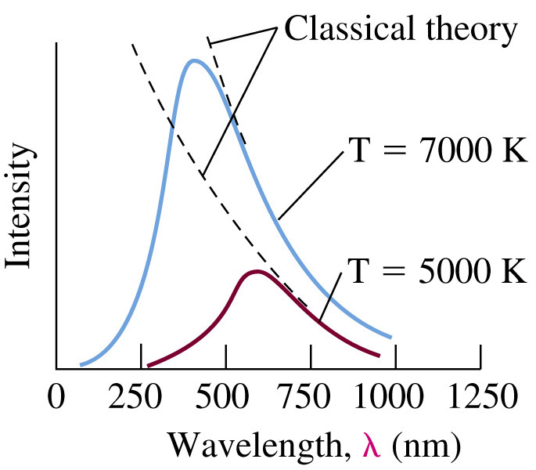
9-3 Quantum Theory
Blackbody Radiation:
Max Planck, 1900:
Energy, like matter, is discontinuous.
є = hν
Notes:
Heated bodies emit light
Blackbody Radiation
I  λ
Classical theory predicts continuous increase of intensity with wavelength.
1900, Max Planck made the revolutionary proposal that ENERGY, LIKE MATTER, IS DISCONTINUOUS.
Introduces the concept of QUANTA of energy.
h = 6.62607 x 10⁻³⁴ J s.

Slide 15
The Photoelectric Effect
Light striking the surface of certain metals causes ejection of electrons.
    ν > ν_{o} threshold frequency
    e⁻  I
    e_{k}  ν

Slide 16
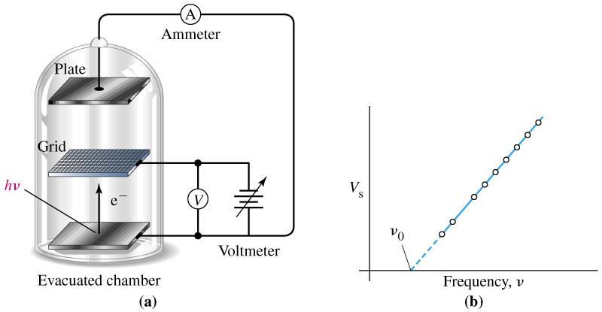
The Photoelectric Effect
Notes:
Phonton strikes a bound eletron which absorbges the energy, if binding energy (known as the work function) is less than photon energy, the e- is ejected.
Stopping voltage of photoelectrons as a function of frequency of incident radiation.
Threshold frequency found by extrapolation.

Slide 17
The Photoelectric Effect
At the stopping voltage the kinetic energy of the ejected electron has been converted to potential.
1
mu² = eV_{s}
2
At frequencies greater than ν_{o}:
V_{s} = k (ν - ν_{o})

Slide 18
The Photoelectric Effect
eV_{o}
E_{k} = eV_{s}
E_{o} = hν_{o}
ν_{o} =
h
eV_{o}, and therefore ν_{o}, are characteristic of the metal.
Conservation of energy requires that:
1
E_{photon} = E_{k} + E_{binding}
hν =
mu² + eV_{o}
2
1
E_{k} = E_{photon} - E_{binding}
eV_{s} =
mu² = hν - eV_{o}
2

Slide 19
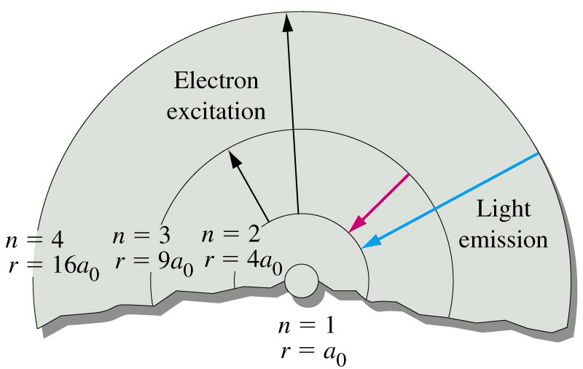
9-4 The Bohr Atom
-R_{H}
E =
n²
R_{H} = 2.179  10⁻¹⁸ J
Notes:
Electrons move in circular orbits about the nucleus.
Motion described by classical physics.
Fixed set of stationary states (allowed orbits).
Governed by angular momentum: nh/2π, n=1, 2, 3….
Energy packets (quanta) are absorbed or emitted when electrons change stationary states.
The integral values are allowed are called quantum numbers.

Slide 20
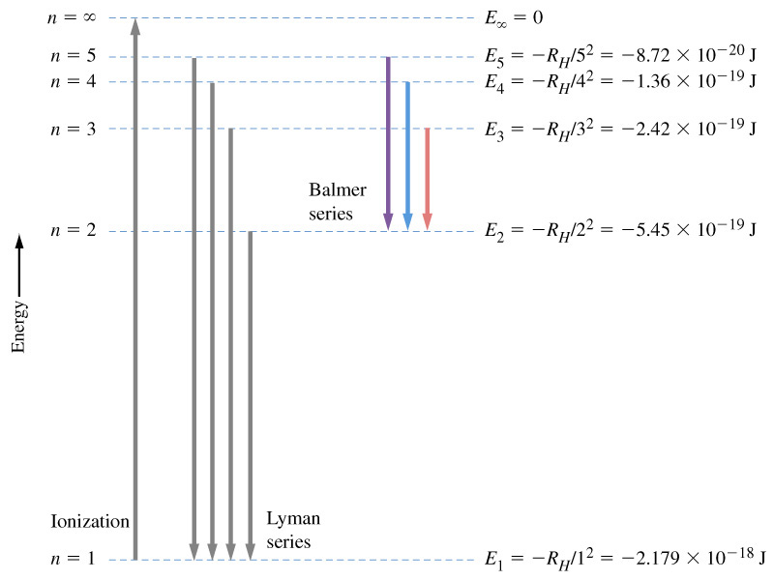
Energy-Level Diagram
-R_{H}
-R_{H}
ΔE = E_{f} – E_{i} =
–
n_{f}²
n_{i}²
1
1
= R_{H} (
–
) = hν = hc/λ
n_{i}²
n_{f}²

Slide 21
Ionization Energy of Hydrogen
1
1
ΔE = R_{H} (
–
) = hν
n_{i}²
n_{f}²
As n_{f} goes to infinity for hydrogen starting in the ground state:
1
hν = R_{H} (
) = R_{H}
n_{i}²
This also works for hydrogen-like species such as He⁺ and Li²⁺.
hν = -Z² R_{H}

Slide 22
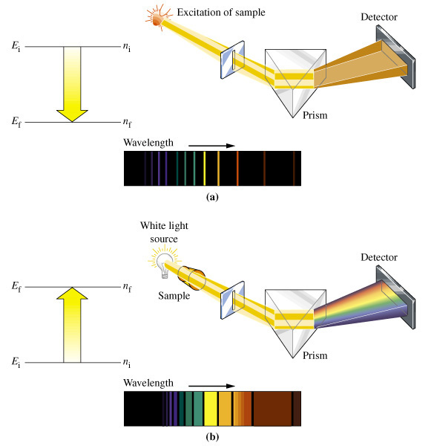
Emission and Absorption Spectroscopy
Notes:
In spite of its accomplishments, there are weaknesses in Bohr theory.
Can’t explain
spectra of species with more than one electron,
effect of magnetic fields on emission spectra
It is an uneasy mixture of classical and non-classical physics.
Modern quantum theory replaced Bohr theory in 1926.

Slide 23
9-5 Two Ideas Leading to a New Quantum Mechanics
Wave-Particle Duality.
  Einstein suggested particle-like properties of light could explain the photoelectric effect.
  But diffraction patterns suggest photons are wave-like.
deBroglie, 1924
  Small particles of matter may at times display wavelike properties.

Slide 24
deBroglie and Matter Waves
E = mc²
hν = mc²
hν/c = mc = p
p = h/λ
λ = h/p = h/mu
Notes:
If matter waves exist for small particles, then beams of particles such as electrons should exhibit the characteristic properties of waves: diffraction.

Slide 25
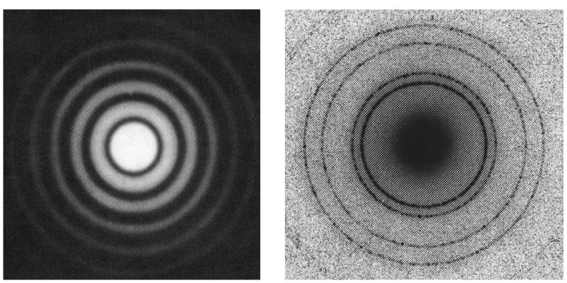
X-Ray Diffraction
Notes:
1927 Davisson aand Germer – Diffraction of slow electrons from a Ni crystal.
1927 Thomson- diffraction from thin metal foil
Nobel prize shared by Davisson and Thomson in 1937.

Slide 26
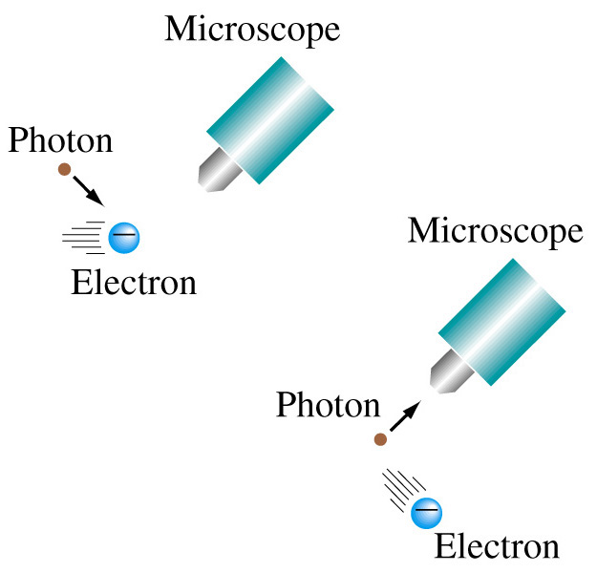
The Uncertainty Principle
Werner Heisenberg
h
Δx Δp ≥
4π

Slide 27
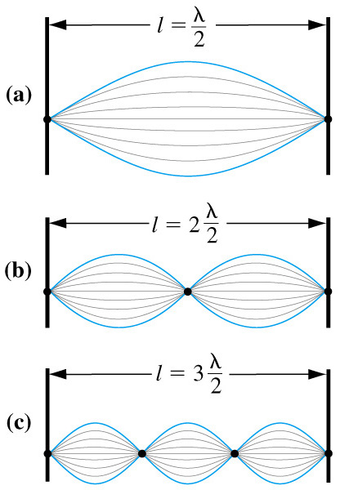
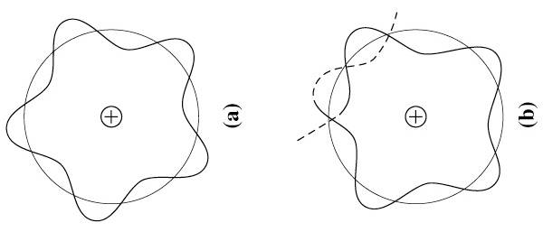
9-6 Wave Mechanics
Standing waves.
  Nodes do not undergo displacement.
  λ = , n = 1, 2, 3…
2L
n

Slide 28
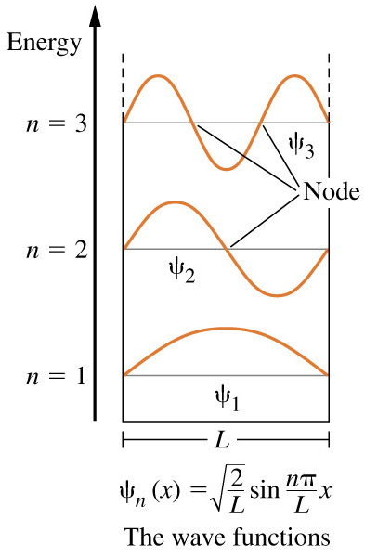
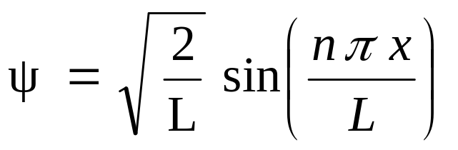
Wave Functions
ψ, psi, the wave function.
  Should correspond to a standing wave within the boundary of the system being described.
Particle in a box.

Slide 29
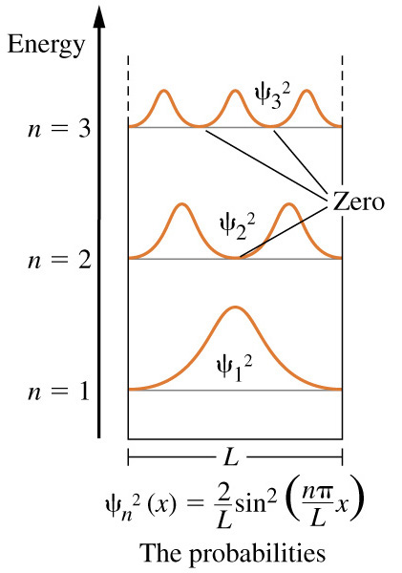
Probability of Finding an Electron

Slide 30
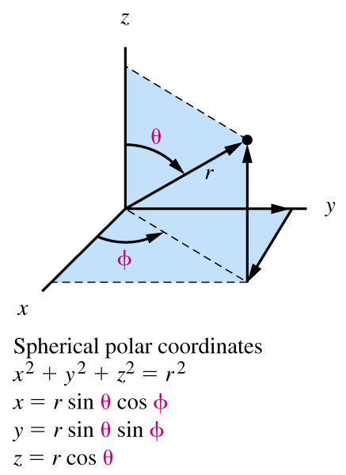
Wave Functions for Hydrogen
Schrödinger, 1927 Eψ = H ψ
  H (x,y,z) or H (r,θ,φ)
  ψ(r,θ,φ) = R(r) Y(θ,φ)
  R(r) is the radial wave function.
  Y(θ,φ) is the angular wave function.

Slide 31
Principle Shells and Subshells
Principle electronic shell, n = 1, 2, 3…
Angular momentum quantum number,
l = 0, 1, 2…(n-1)
  l = 0, s
  l = 1, p
  l = 2, d
  l = 3, f
Magnetic quantum number, m_{l}= - l …-2, -1, 0, 1, 2…+l

Slide 32
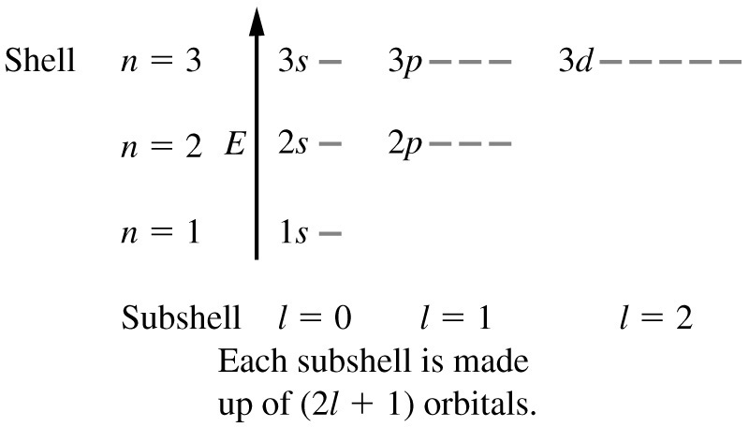
Orbital Energies

Slide 33
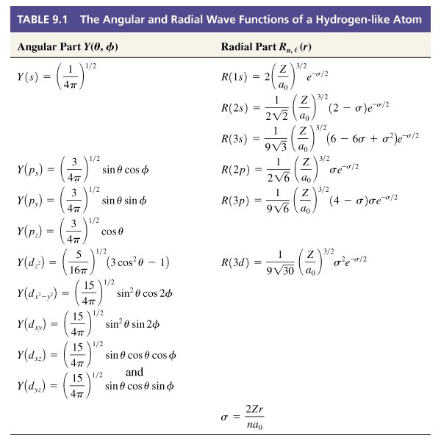
9-8 Interpreting and Representing the Orbitals of the Hydrogen Atom.

Slide 34
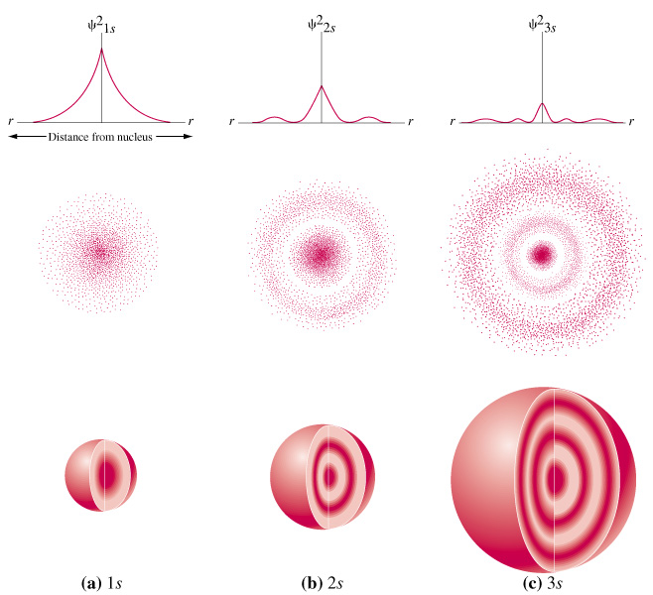
s orbitals

Slide 35
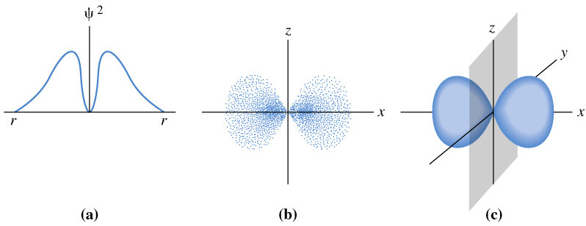
p Orbitals
Notes:
Value of psi squared
Dots represent electron probability in a plane passing through the nucleus
Electron probability and charge density represented in three dimensions. Note that it is not spherically symmetric.

Slide 36
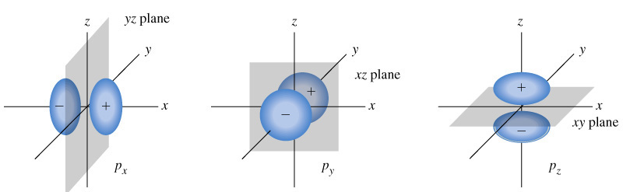
p Orbitals

Slide 37
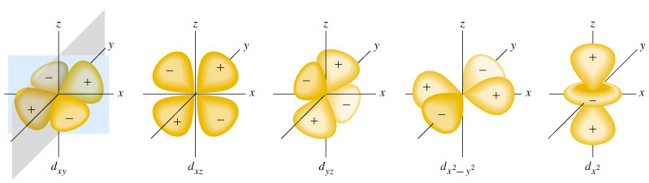
d Orbitals

Slide 38
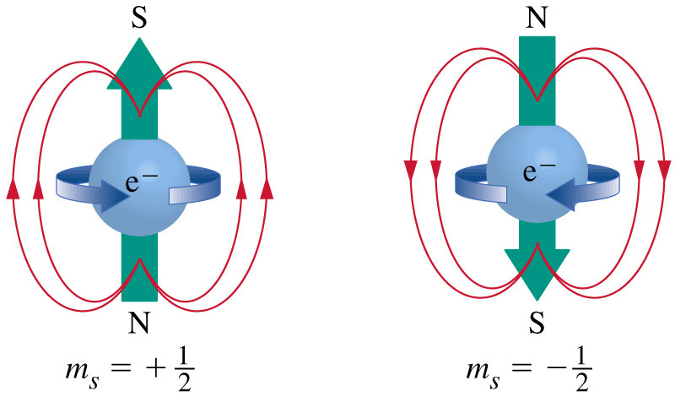
9-9 Electron Spin: A Fourth Quantum Number

Slide 39
9-10 Multi-electron Atoms
Schrödinger equation was for only one e⁻.
Electron-electron repulsion in multi-electron atoms.
Hydrogen-like orbitals (by approximation).

Slide 40
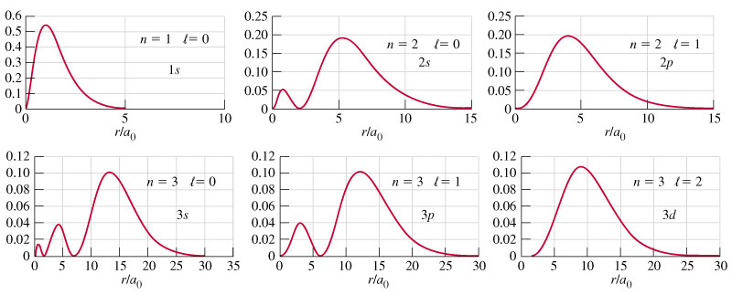
Penetration and Shielding
Z_{eff} is the effective nuclear charge.

Slide 41
9-11 Electron Configurations
Aufbau process.
  Build up and minimize energy.
Pauli exclusion principle.
  No two electrons can have all four quantum numbers alike.
Hund’s rule.
  Degenerate orbitals are occupied singly first.

Slide 42
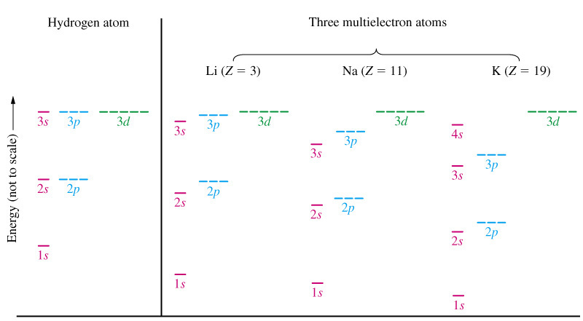
Orbital Energies

Slide 43
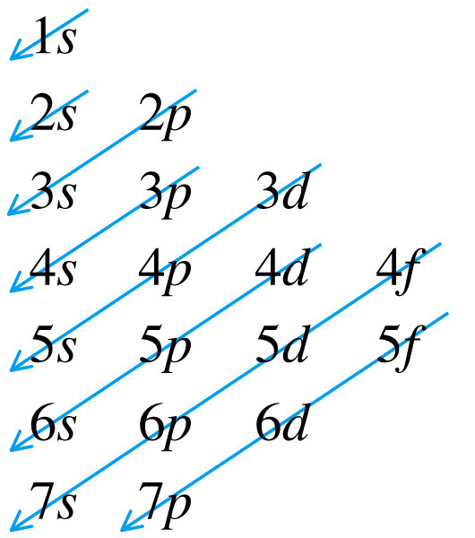
Orbital Filling

Slide 44
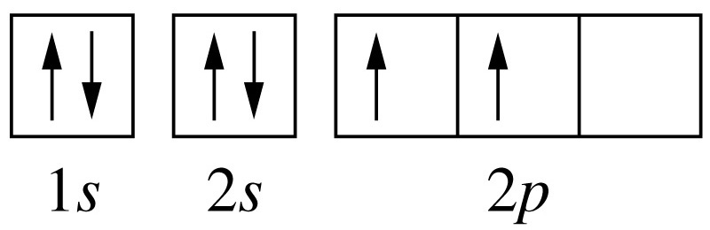
Aufbau Process and Hunds Rule

Slide 45
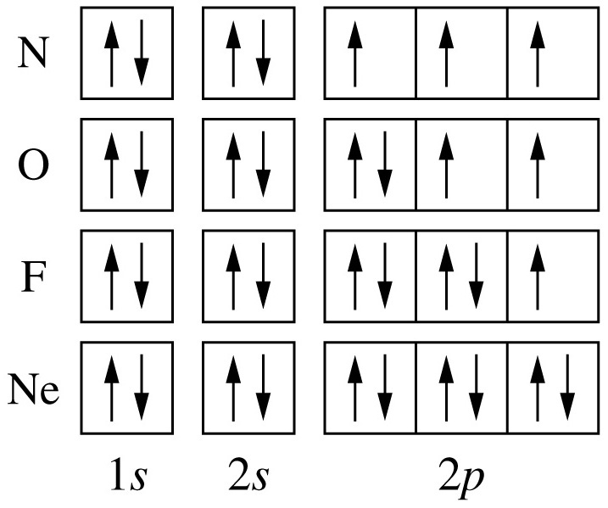
Filling p Orbitals

Slide 46
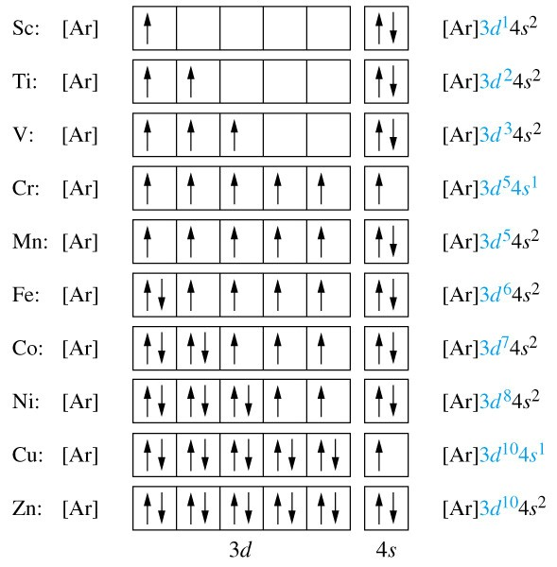
Filling the d Orbitals

Slide 47
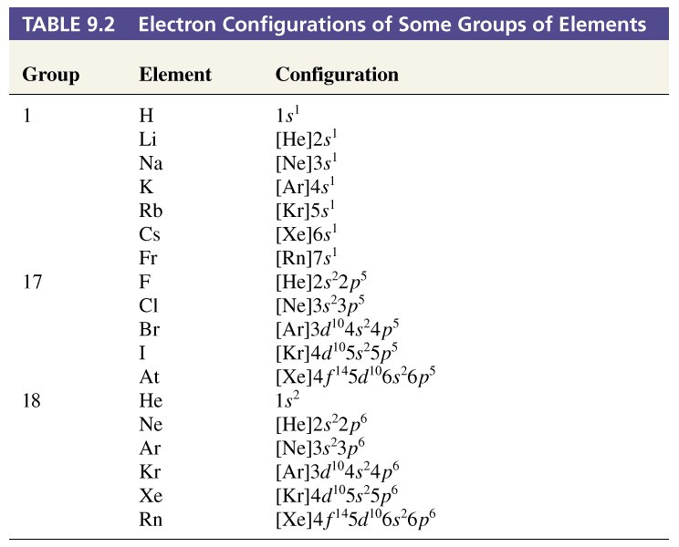
Electon Configurations of Some Groups of Elements

Slide 48
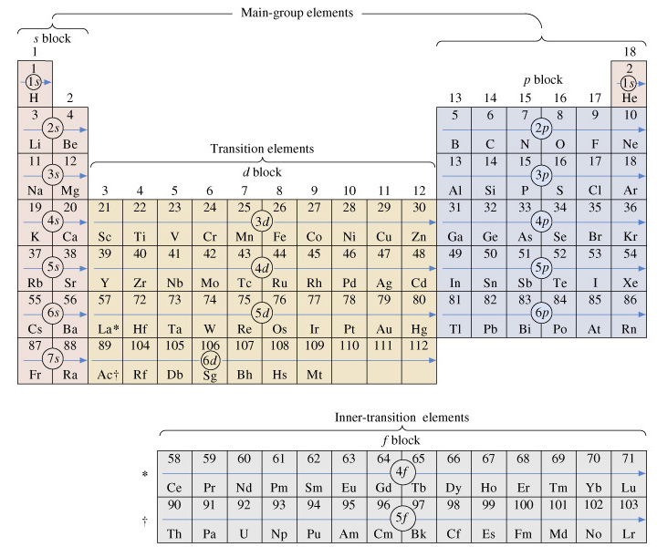
9-12 Electron Configurations and the Periodic Table

Slide 49
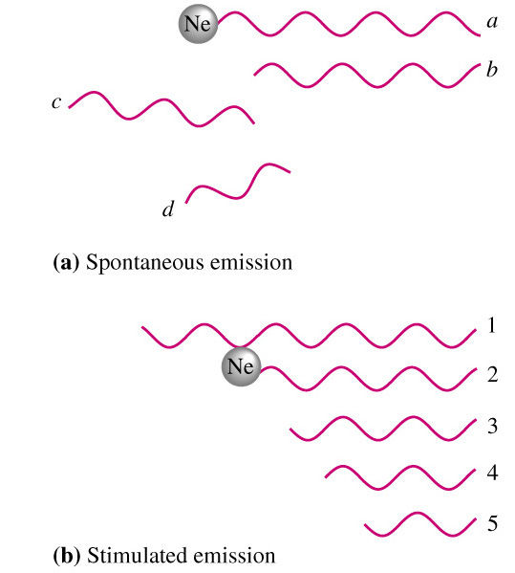
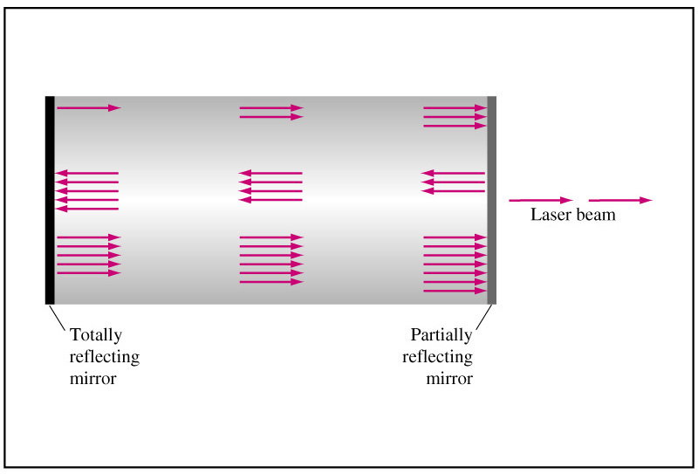
Focus on He-Ne Lasers

Slide 50
Chapter 9 Questions
1, 2, 3, 4, 12, 15, 17, 19, 22, 25, 34, 35, 41, 67, 69, 71, 83, 85, 93, 98

